Slide 1

BASS Diffusion Model (for New Product Diffusion)

Slide 2
MKT 591: Course Roadmap
Review of Quant Market Research
Prediction / Regression
Forecasting
Features & Dimensions
Market Segmentation
Simple Linear Regression
Demand Forecasting
Customer Classification
Factor Analysis
Segmentation Basic
Measurement Scales
Categorical Variables
BASS Diffusion Model
Discriminant Analysis
MDS
Advanced Model-based Segmentation
Discrete Analysis (CrossTab)
Extracting Features by Text Analytics
Multiple Regression
Bayesian Classifier
Spatial Segmentation
Continuous Analysis (Correlation)
Issues in Regression
Tree Models
Deep Learning
Logistic Regression (Consumer Choice)
Bayesian Statistics

Slide 3
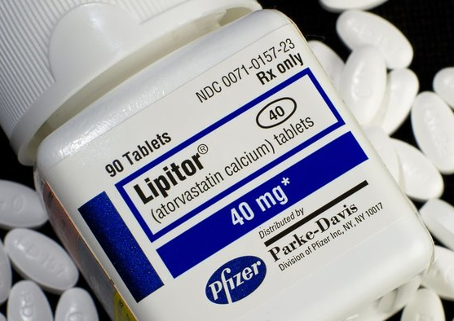
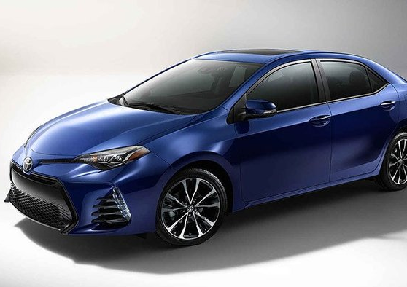

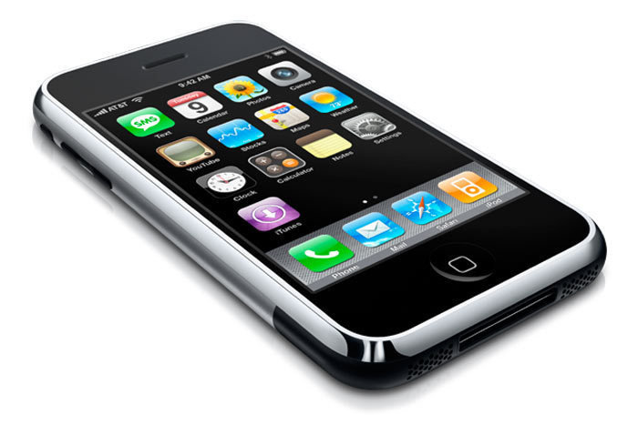
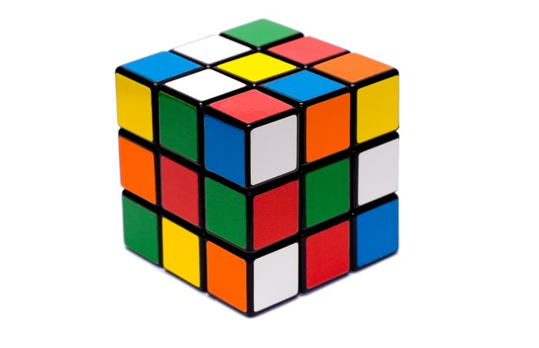
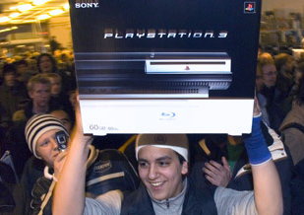
Please guess what are these?
Notes:
https://www.crowdspring.com/blog/successful-product-design/

Slide 4
New Product Research
As many as 95 percent of new products introduced each year fail, according to Cincinnati research agency AcuPoll (Forbes.com, 2010).
New product development(product innovation) is an important issue and a classic research topic in marketing strategy and quant marketing.
Marketers want to understand market mechanisms that will likely determine the amount of penetration of an innovation (new product) in a market.
Also, it is important to reasonably forecast demand for Efficient Supply Chain management.
Notes:
4P, product price promotion place

Slide 5
Innovation Diffusion: Conceptual Descriptions
Today, let’s start to discuss about
academic literature for this model first.
Reference Book: “Innovation Diffusion and New Product Growth” by Muller, Peres, and Mahajan, 2009, MSI, Cambridge, MA

Slide 6
3M example
What is an Innovation?
A classic important research topic in Marketing
The process of bringing new products or services to the market to enhance firm profitability ^{[1]}.
The importance of innovation:
Innovation is responsible for raising product quality and raising/reducing prices.
It dramatically improves consumers’ lives.
It destroys existing markets, transforms old ones, or creates new ones.
It can bring down giant incumbents and propel small outsiders into dominant positions.
Hauser, Tellis, Griffin 2006

Slide 7
Types of Innovation
What about other types of innovations? ^{[1]}:
INCREMENTAL INNOVATION [minor change in technology + low incremental customer benefit per dollar] | TECHNOLOGICAL BREAKTHROUGH [major change in technology + low incremental customer benefit per dollar]
MARKET BREAKTHROUGH [minor change in technology + high incremental customer benefits per dollar] | RADICAL INNOVATION [major change in technology + high incremental customer benefits per dollar]
High ----- Customer Benefits Change ----- Low
Minor Change ------ Technology ---- Major Change
Chandy and Tellis (1998) Journal of Marketing.

Slide 8
Radical Innovation
Radical Innovations: “Really New Products”:
These products use substantially new technology and provide substantially grater customer benefits per dollar. ^{[1]}
Some historical examples: Word Processors, Celluloid Film Cameras, Digital Cameras, Telephones, Cellular Phones, Smart Phone, Hybrid Cars, LED light bulbs, Electronic car, etc.,
Word processors displaced typewriters
Digital cameras displaced Film cameras.
Digital Music Players; Book Readers (e.g., Amazon Kindle 2007)
Chandy and Tellis 1998

Slide 9
Analytics Interest related to New Product:
Innovation Diffusion
Let’s assume that a firm has an innovation (new product) for commercialization that satisfies a collection of consumer needs.
‘Diffusion’ in the field of marketing is the study of the spread (aggregate sales) of the innovation from ‘launch’ to ‘end of life’. -- ‘New Product Life Cycle’ is a similar concept (alternative).
Important caveats:
1. The innovation has to be radical i.e., not similar to existing products in the market.
2. This model measures spread (aggregate sales) at the product category level.

Slide 10
The name ‘Diffusion’ in dictionary meaning?
Why the name ‘Diffusion’?
Diffusion Example

Slide 11
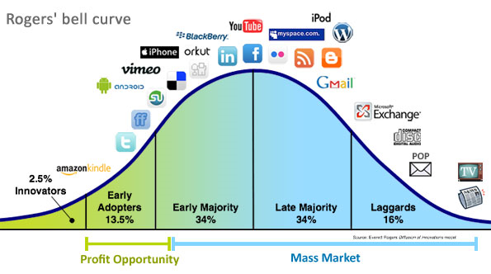
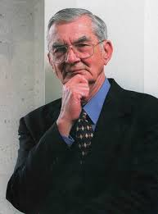
Brief History of Diffusion Theory
Sociologist Gabriel Tarde was the first to study innovation diffusion ^{[1]}. His idea was based on imitation by social agents.
Everett Rogers published his very influential book on the influence of communication channel, time and a social system.
Frank M. Bass, a marketing professor is widely considered the first person to propose a formal model of innovation diffusion. It is now called the Bass Model or New Product Growth model.
Kinnunen 1996

Slide 12
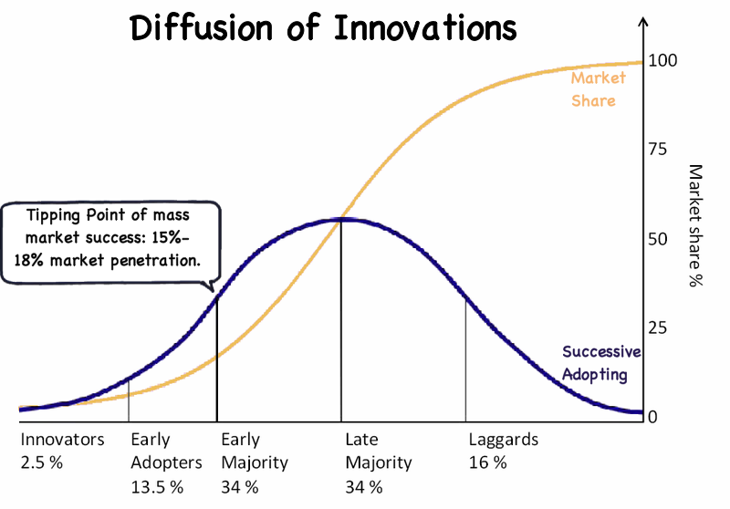
Graphical Representation of The Rogers Model
The Rogers Model

Slide 13
Diffusion History
The Rogers Model – A Qualitative Analysis of Adopters ^{[1]}
Innovators | Risk takers Financially sound Higher up the social class ladder
Early Adopters | Opinion leaders Like innovators but more discrete on product choice
Early Majority | Networked with opinion leaders Slow adopters
Late Majority | Skeptics Need high degree of confirmation
Laggards | Traditionalists Averse to change-agents
Innovators
Imitators/Followers
1. Rogers 1962

Slide 14

Diffusion Modeling?
The model includes two part for diffusion:
Innovators
Imitators
For the imitators part, theoretically the effects of social influence(e.g., effects of social networks) can explain large part of the diffusion.
Notes:
Reflecting Social Influence (e.g., SNS data, Tweeter Friends Data) on Diffusion Speed.

Slide 15
Social Influence (Relevant Marketing Literature for Imitators)
To understand market mechanisms that predict the (possible) amount of penetration of a new product (the primary interest of marketers), we need to understand various types of social influence.
Examples of Social Influence:
A. Word – of – Mouth Communications: Verbal or written communication amongst consumers such as conversations, email, participation in social groups and social activities drive adoptions. – eWOM (Online Review, etc.) recently…
B. Signals: Market information other than personal recommendation that is used by a potential adopter.
C. Network Externalities: As more consumers adopt a successful new product, the utility of other relevant products increases.

Slide 16
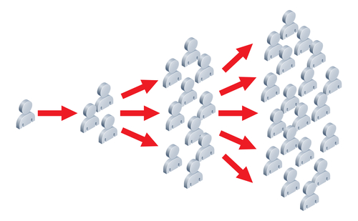
A. Word – of – Mouth Communications
From marketing literature…
According to Ehrenberg-Bass Institute for Marketing Science, brands must create word of mouth beyond core fan groups.
2. The effect of word of mouth is higher for low frequency purchases, high perceived risk products, high monetary value purchases, and high involvement products.^{[1]}
3. Word-of-mouth of loyal customers is a major driver.^{[2]} In other circumstances, word-of-mouth of non-loyal customers is vital for adoption.^{[3]}
1. Rosen 2000; Watts and Dodds 2007; 2. Reicheld 2003; 3. Godes and Mayzlin 2009

Slide 17
B. Signals
Number of previous customers serves as a quality signal – influence imitators (e.g., if many customers adopted, it is a positive signal to imitators)
Social signals are transmitted to followers of aspirational group member ^{[1]}. E.g., celebrity endorsements.
Speed of innovation diffusion increases in societies that are more sensitive to status differences^{[2]}.
1.Van den Bulte and Wuyts 2007, Van den Bulte and Joshi 2007; 2. Van den Bulte and Stremersch 2004

Slide 18
C. Network Externalities (infrastructure):
Network externalities can be direct (e.g., smart phone services - voice chat apps; computer – LCD monitor) or indirect based on user base of complimentary products – Value of the product can be changed ^{[1]}.
It is a positive influence on product sales and penetration^{[2]}.
1. Stremersch et al 2007; 2. Nair, Chintagunta, and Dube 2004, Telis, Yin, and Niraj 2009; 3. Goldenberg, Libai and Muller 2010

Slide 19
Other than Social Influence
Consumer Heterogeneity alone can drive diffusion in the absence of any form of social influence. – One of the most popular research topic in marketing research; E.g., some consumers are innovators or early adaptors without social influences.
Consumer differences can be in ‘Innovativeness’, ‘Price Sensitivity’, ‘Needs’, ‘Willingness to Pay’, ‘Patience’ etc.
Diffusion Drivers
Consumer Heterogeneity
Social Influence
Word-of-mouth
Signaling
Network Externalities
1. Stremersch et al 2007; 2. Nair, Chintagunta, and Dube 2004, Telis, Yin, and Niraj 2009; 3. Goldenberg, Libai and Muller 2010
Notes:
Heterogeneity: 异质性

Slide 20
Now, Quantitative Modeling! for New Product Diffusion

Slide 21
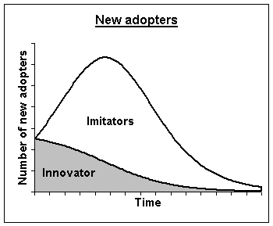
BASS Model
One of the most cited empirical generalization model in marketing
It consists of a simple differential equation that describes the process of how new products get adopted (wiki)
The model presents a (theoretical) rationale of how innovative adopters and imitating adopters of a new product interact – We previously discussed some rationales.

Slide 22
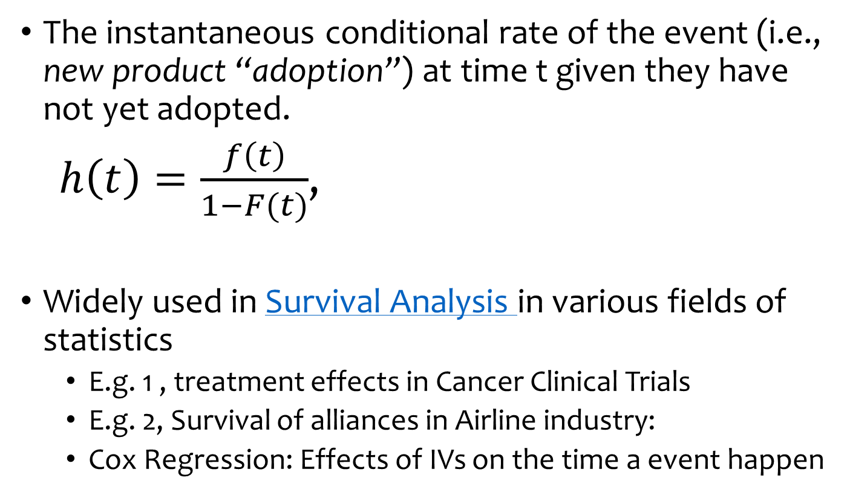
Hazard Rate in Statistics
The instantaneous conditional rate of the event (i.e., new product “adoption”) at time t given they have not yet adopted.
$h\left(t\right)=\frac{f\left(t\right)}{1−F(t)}$,
Widely used in Survival Analysis in various fields of statistics
E.g. 1 , treatment effects in Cancer Clinical Trials
E.g. 2, Survival of alliances in Airline industry:
Cox Regression: Effects of IVs on the time a event happen
Instantaneous rate of the adoption
Probability that the adoption is not occurred yet.
Notes:
f(t) – likelihood or rate of purchase/adopt (different from probability in continuous density function)

Slide 23
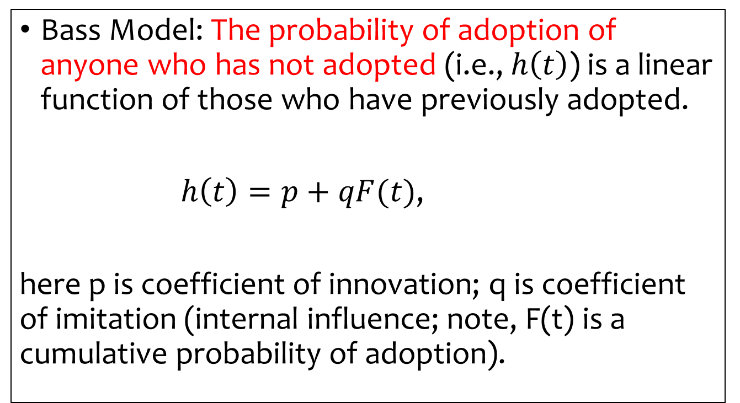
BASS Modeled the diffusion this way!
Bass Model: The probability of adoption of anyone who has not adopted (i.e., $h\left(t\right)$) is a linear function of those who have previously adopted.
$h\left(t\right)=p+qF(t)$,
here p is coefficient of innovation; q is coefficient of imitation (internal influence; note, F(t) is a cumulative probability of adoption).

Slide 24
Graphical Pattern of Adoptions
Cumulative Adoption Graph
Adoption Distribution Graph
Chengjun WANG (2012)

Slide 25
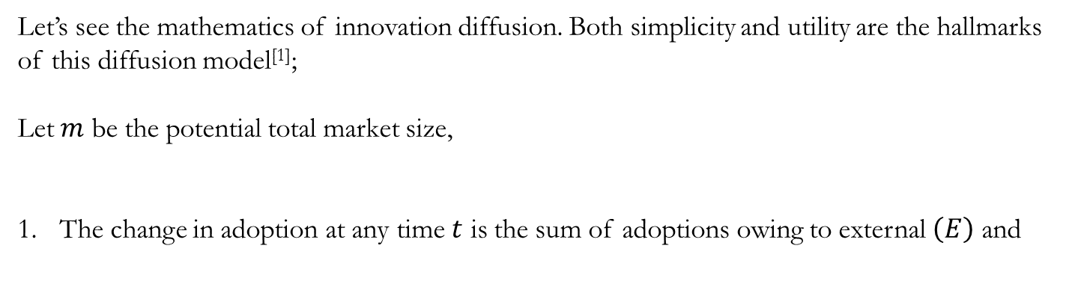
Technical Summary of Bass Model
Let’s see the mathematics of innovation diffusion. Both simplicity and utility are the hallmarks of this diffusion model^{[1]};
Let $m$ be the potential total market size,
The change in adoption at any time $t$ is the sum of adoptions owing to external $\left(E\right)$ and
Hazard function:
adoption
innovators
imitators
f(T) : likelihood of purchase at time T.
F(T) : Cumulative purchase/adoption probability by time T; F(0)=0.
Y(T): the total number of purchases in the (0,T).
m: total market potential (total number of purchases).
Note, S(T) = mf(T); Y(T) = mF(T)
1. Bass (1969) Management Science

Slide 26
Derivation of Bass Model
After having some algebra, we have:
“I will show how to derive the BASS Diffusion model…
Let’s do some basic Mathematics!”
Our interests are p, q, and m:
Question: How can we estimate this equation?
$$here, a=pm;b=q−p;c=−\frac{q}{m}$$
$a+mb+cm^{2}=0$ $m=−b±\frac{\sqrt{b^{2}−4ac}}{2c}$, we can estimate p, q and m!
Applying Quadratic Formula

Slide 27
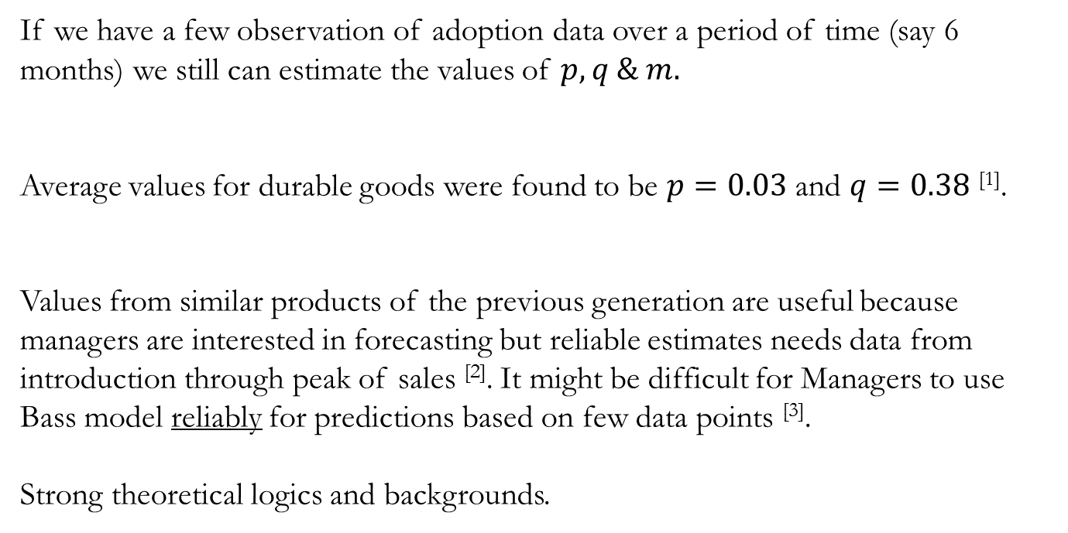
Benefits of Bass Model
If we have a few observation of adoption data over a period of time (say 6 months) we still can estimate the values of $p, q \& m.$
Average values for durable goods were found to be $p=0.03$ and $q=0.38$ ^{[1]}.
Values from similar products of the previous generation are useful because managers are interested in forecasting but reliable estimates needs data from introduction through peak of sales ^{[2]}. It might be difficult for Managers to use Bass model reliably for predictions based on few data points ^{[3]}.
Strong theoretical logics and backgrounds.
1. Sultan, Farley, and Lehman 1990; 2. Srinivasan and Mason 1986; 3. Putnis and Srinivasan 2000
Notes:
As we said we want to do scientific guess supported by data…

Slide 28
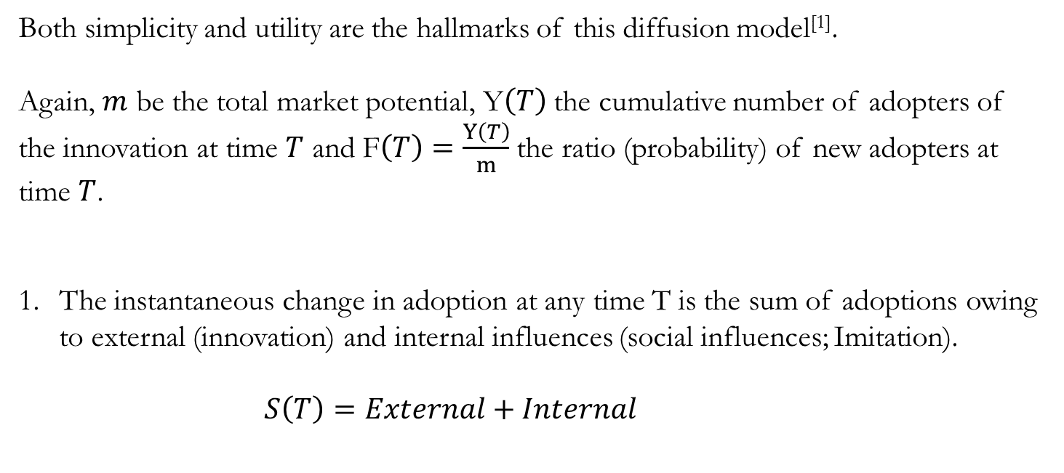
Properties of Bass Model (1)
Both simplicity and utility are the hallmarks of this diffusion model^{[1]}.
Again, $m$ be the total market potential, Y$\left(T\right)$ the cumulative number of adopters of the innovation at time $T$ and F$\left(T\right)=\frac{Y\left(T\right)}{m}$ the ratio (probability) of new adopters at time $T$.
The instantaneous change in adoption at any time T is the sum of adoptions owing to external (innovation) and internal influences (social influences; Imitation).
$$S\left(T\right)=External+Internal$$
1. Bass 1969

Slide 29
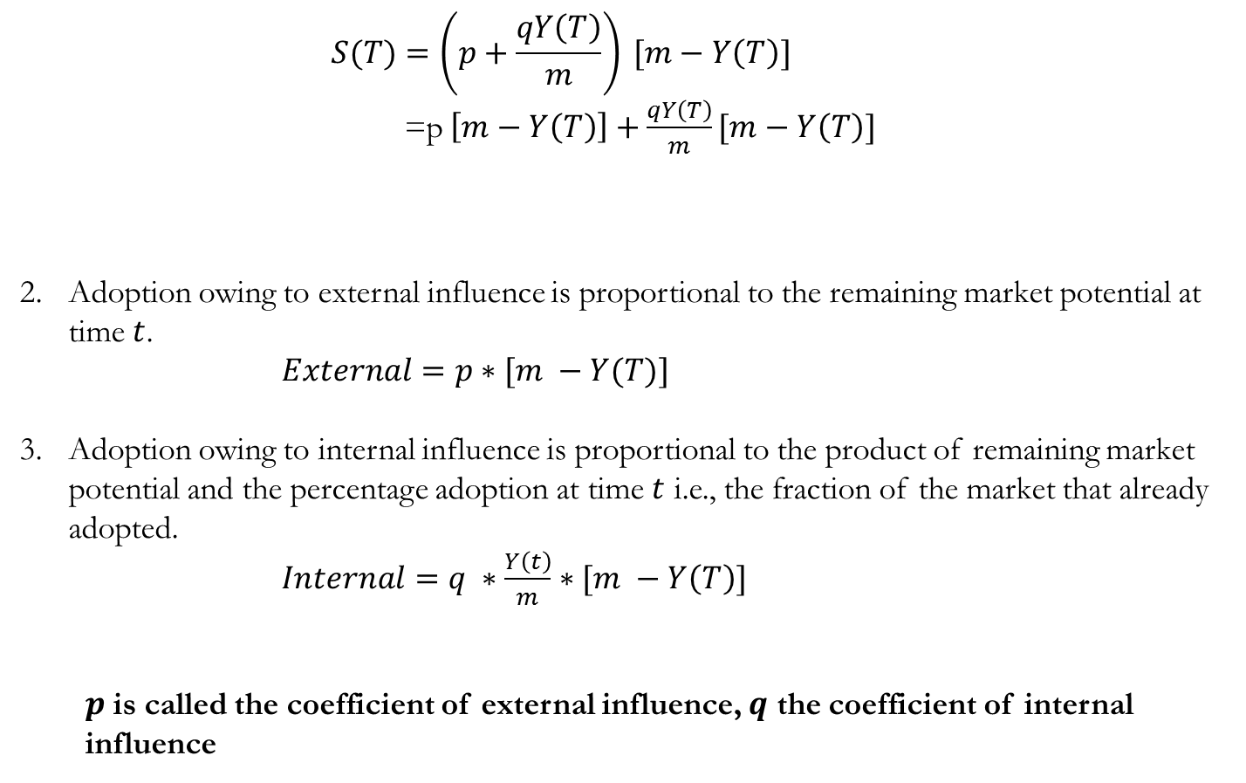
Properties of Bass Model (2)
$$S(T)=\left(p+\frac{qY\left(T\right)}{m}\right) [m−Y\left(T\right)]$$
=p $\left[m−Y\left(T\right)\right]+\frac{qY\left(T\right)}{m}[m−Y\left(T\right)]$
Adoption owing to external influence is proportional to the remaining market potential at time $t$.
$External=p∗[m −Y(T)]$
Adoption owing to internal influence is proportional to the product of remaining market potential and the percentage adoption at time $t$ i.e., the fraction of the market that already adopted.
$Internal=q ∗\frac{Y\left(t\right)}{m}∗[m −Y\left(T\right)]$
$p$ is called the coefficient of external influence, $q$ the coefficient of internal influence
External Effects
Internal Effects

Slide 30
Sample Curves
Mobile Phones in Norway 1981 – 2004; p = 0.0046; q = 0.33; m = 4.99 million

Slide 31

A Marketing Analytics Project in 2017
Using Electronic Car TESLA Sales in Norway.
Applied BASS model and Exponential Smoothing Model using R

Slide 32
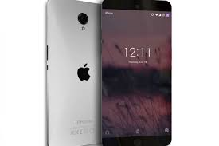
In-class Example in R
Term | Sales
2007 Q3 | 0.27
2007 Q4 | 1.119
2008 Q1 | 2.315
2008 Q2 | 1.783
2008 Q3 | 0.757
2008 Q4 | 6.892
2009 Q1 | 4.363
2009 Q2 | 3.793
2009 Q3 | 5.288
2009 Q4 | 7.367
2010 Q1 | 8.737
2010 Q2 | 8.752
2010 Q3 | 8.358
2010 Q4 | 14.142
2011 Q1 | 14.235
2011 Q2 | 16.647
2011 Q3 | 20.338
2011 Q4 | 17.073
2012 Q1 | 37.044
2012 Q2 | 35.064
2012 Q3 | 26.028
2012 Q4 | 25.91
2013 Q1 | 47.789
iphone Sales Data after launching a new product (millions)
Notes:
Please explain R code line by line this case.

Slide 33
In-class Example in R
What is the estimated coefficient of innovation based on the historical iPhone sales data?
What is the estimated coefficient of imitation?
What is influence of ‘p’ (the coefficient of external influence) and the remaining total market size ‘m-Y(t)’)
What is predicted sales by using Bass Model for 2,3 and 4 Quarters of 2013

Slide 34
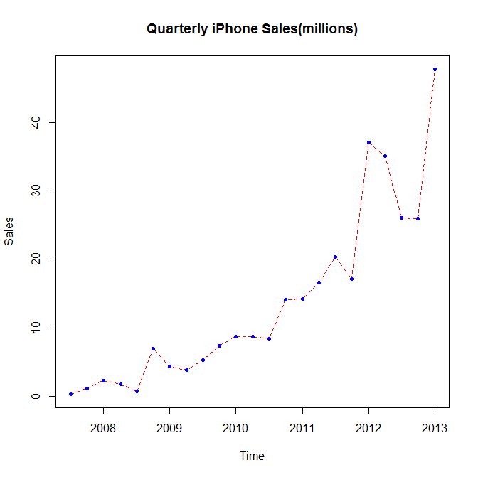
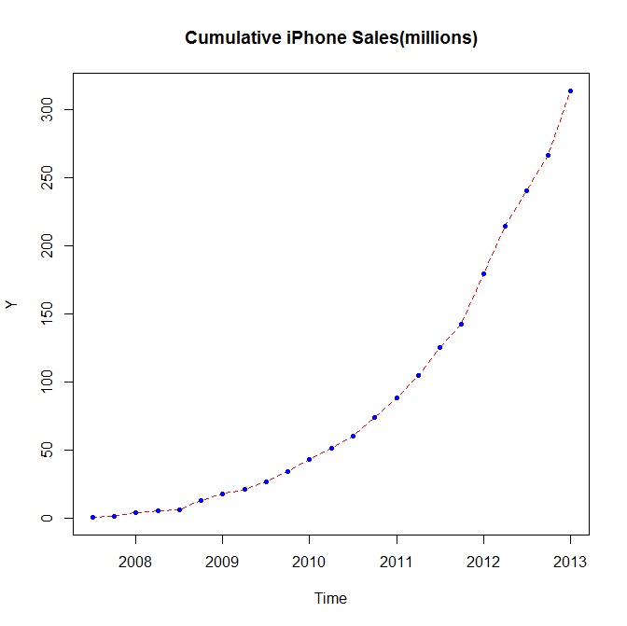
Plot for Actual Data

Slide 35
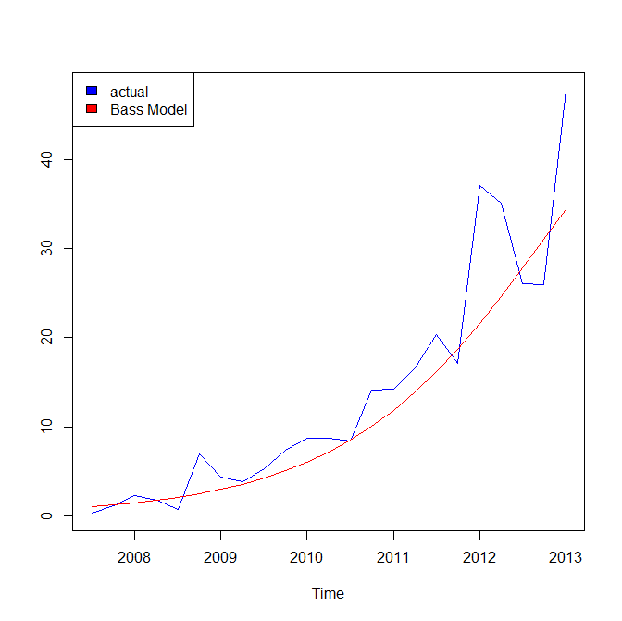
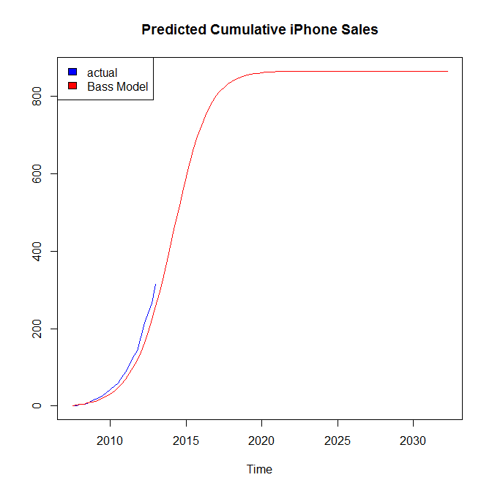
BASS MODEL Application

Slide 36
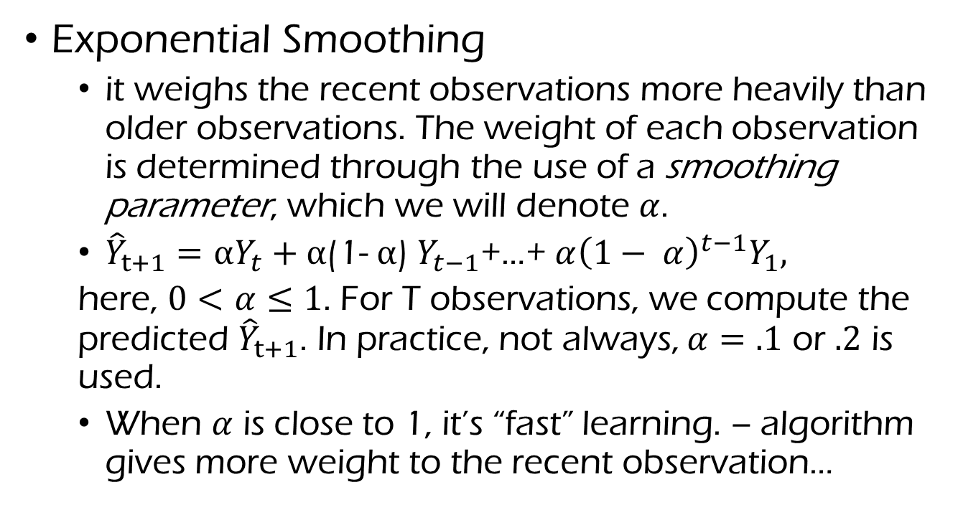
Other Forecasting Models
Exponential Smoothing
it weighs the recent observations more heavily than older observations. The weight of each observation is determined through the use of a smoothing parameter, which we will denote $α$.
${\hat{Y}}_{t+1}=αY_{t}+$ $α$(1- $α$) $Y_{t−1}$+…+ $α{\left(1− α\right)}^{t−1}Y_{1},$
here, $0<α≤1$. For T observations, we compute the predicted ${\hat{Y}}_{t+1}$. In practice, not always, $α=.1$ or $.2$ is used.
When $α$ is close to 1, it’s “fast” learning. – algorithm gives more weight to the recent observation…

Slide 37
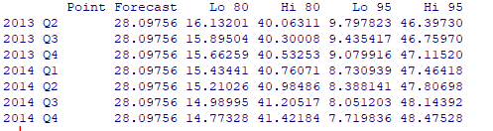

Prediction by 2014 Q4 by Simple Exponential Smoothing
$$α=0.2$$
Compared with the SES, what are possible benefits of BASS model?
Notes:
Theoretical rational and we can understand market structured by estimating p, q, and m…

Slide 38
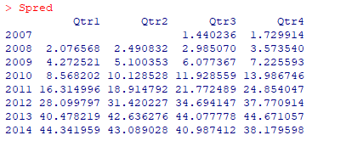
Prediction by 2014 Q4 using Bass Model

Slide 39

In-Class Practice : Samsung Galaxy Data
What is the estimated coefficient of innovation based on the historical Samsung Galaxy example sales data?
What is the estimated coefficient of imitation?
What is influence of ‘p’ (the coefficient of external influence) and the remaining total market size ‘m-Y(t)’)
What is predicted sales by the Bass Model for 2,3 and 4 Quarters of 2013

Slide 40
Implications
Estimation of the Bass Curve (p, q and m) is useful for forecasting and diagnosing the future sales/adoptions of the innovation (i.e., growth of the new product) – Reasonable guess is better than random guess!
Critical product decisions regarding product attributes, pricing and promotion, subsidizing complementary hardware/software, distribution etc. rely on such a forecast.[1]
What else can you think of?
1. Moon 2003, Ofek 2005

Slide 41
Some Comments
This is aggregate-level adoption model. For modeling individual-level adoptions, recently new modeling approaches (e.g., agent-based modeling – simulation technique) are suggested.
They restricted the interest in sales to that time interval for which replacement sales are excluded, although the interest in initial purchase will extend beyond this interval. (This model is focusing “adoption”)
Sometimes, there is an extraordinary slowness in diffusion. Some successful durable products in the US had taken (on average) more than 6 years to reach 25% of market potential, over 9 years to reach 50% and about 18 years to reach 95%. (This is because social influences do not kick start until a sufficient adoption critical mass is reached).
So entrepreneurs shouldn’t get too excited.

